Slide 1
Power system Fault detection and classification using machine learning
CAPSTONE PROJECT
Presented By:
Balaga Tejomahima - Malla Reddy College of Engineering & Technology-CSE

Slide 2
OUTLINE
Problem Statement
Proposed System/Solution
System Development Approach (Technology Used)
Algorithm & Deployment
Result (Output Image)
Conclusion
Future Scope
References

Slide 3
Problem Statement
Design a machine learning model to detect and classify different types of faults in a power distribution system. Using electrical measurement data (e.g., voltage and current phasors), the model should be able to distinguish between normal operating conditions and various fault conditions (such as line-to-ground, line-to-line, or three-phase faults). The objective is to enable rapid and accurate fault identification, which is crucial for maintaining power grid stability and reliability.

Slide 4
Proposed Solution
The proposed system aims to detect and classify power system faults using machine learning techniques. By analyzing electrical phasor data (voltage and current), the system will accurately identify normal and faulty conditions:
Data Collection:
Use the Kaggle dataset containing voltage and current measurements.
Include labeled data for various fault types (e.g., LG, LL, LLG, LLL, LLLG, No Fault).
Data Preprocessing:
Clean data, handle missing values, normalize phasors.
Encode fault types as numerical labels.
Perform feature extraction to enhance model learning.
Machine Learning Algorithm:
Implement algorithms like Random Forest, SVM, or ANN for classification.
Train the model to distinguish between fault types based on input features.
Deployment:
Use IBM Watson Studio for development.
Store data in IBM Cloud Object Storage.
Deploy the trained model using Watson Machine Learning with a REST API.
Evaluation:
Measure performance using accuracy, precision, recall, and F1-score.
Use confusion matrix to analyze prediction quality.

Slide 5
System Approach
The System Approach outlines the methodology and technical strategy used to develop and implement the machine learning model for power system fault detection and classification:
System requirements
Hardware:
Processor: Intel i5/i7 or equivalent
RAM: 8 GB or more
Storage: Minimum 2 GB free space
Internet connectivity (for IBM Cloud)
Software:
Operating System: Windows, Linux, or macOS
IBM Cloud Lite Account (mandatory)
Python (v3.7+)
Jupyter Notebook or IBM Watson Studio
Library required to build the model

Slide 6
Algorithm & Deployment
In the Algorithm section, describe the machine learning algorithm chosen for predicting faulty type. Here's an example structure for this section:
Algorithm Selection:
The Random Forest Classifier is used due to its high accuracy, robustness, and ability to handle complex, non-linear relationships in phasor data. It performs well for multi-class classification problems like fault type detection.
Data Input:
Input features include:
Voltage: Va, Vb, Vc
Current: Ia, Ib, Ic The target output is the fault type .
Training Process:
Data is cleaned, scaled, and split
Labels are encoded
Random Forest is traines using cross-validation and optimized using hyperparameter tuning
Prediction Process:
The trained model takes real-time phasor data and predicts the fault type.
It is deployed on IBM Watson Machine Learning and accessible via a REST API for real-time use in power systems.

Slide 7
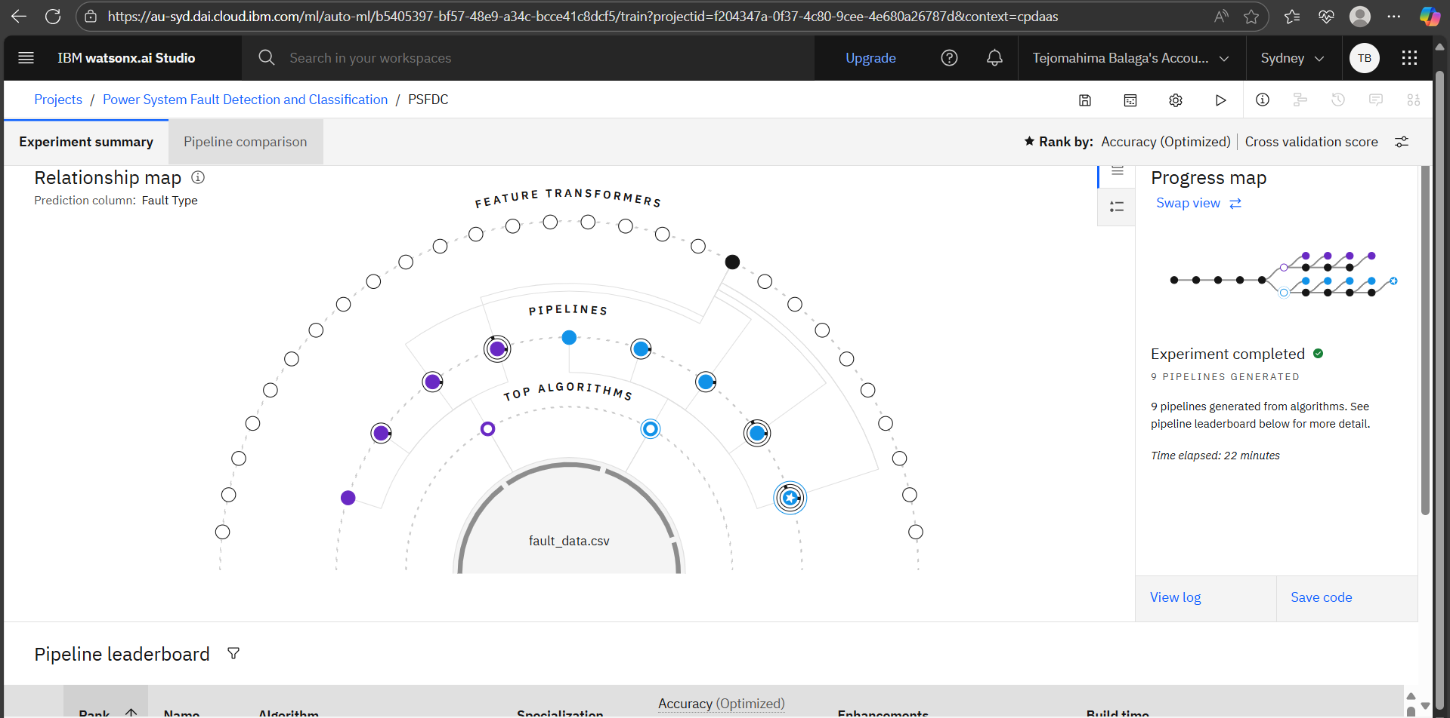
Result

Slide 8
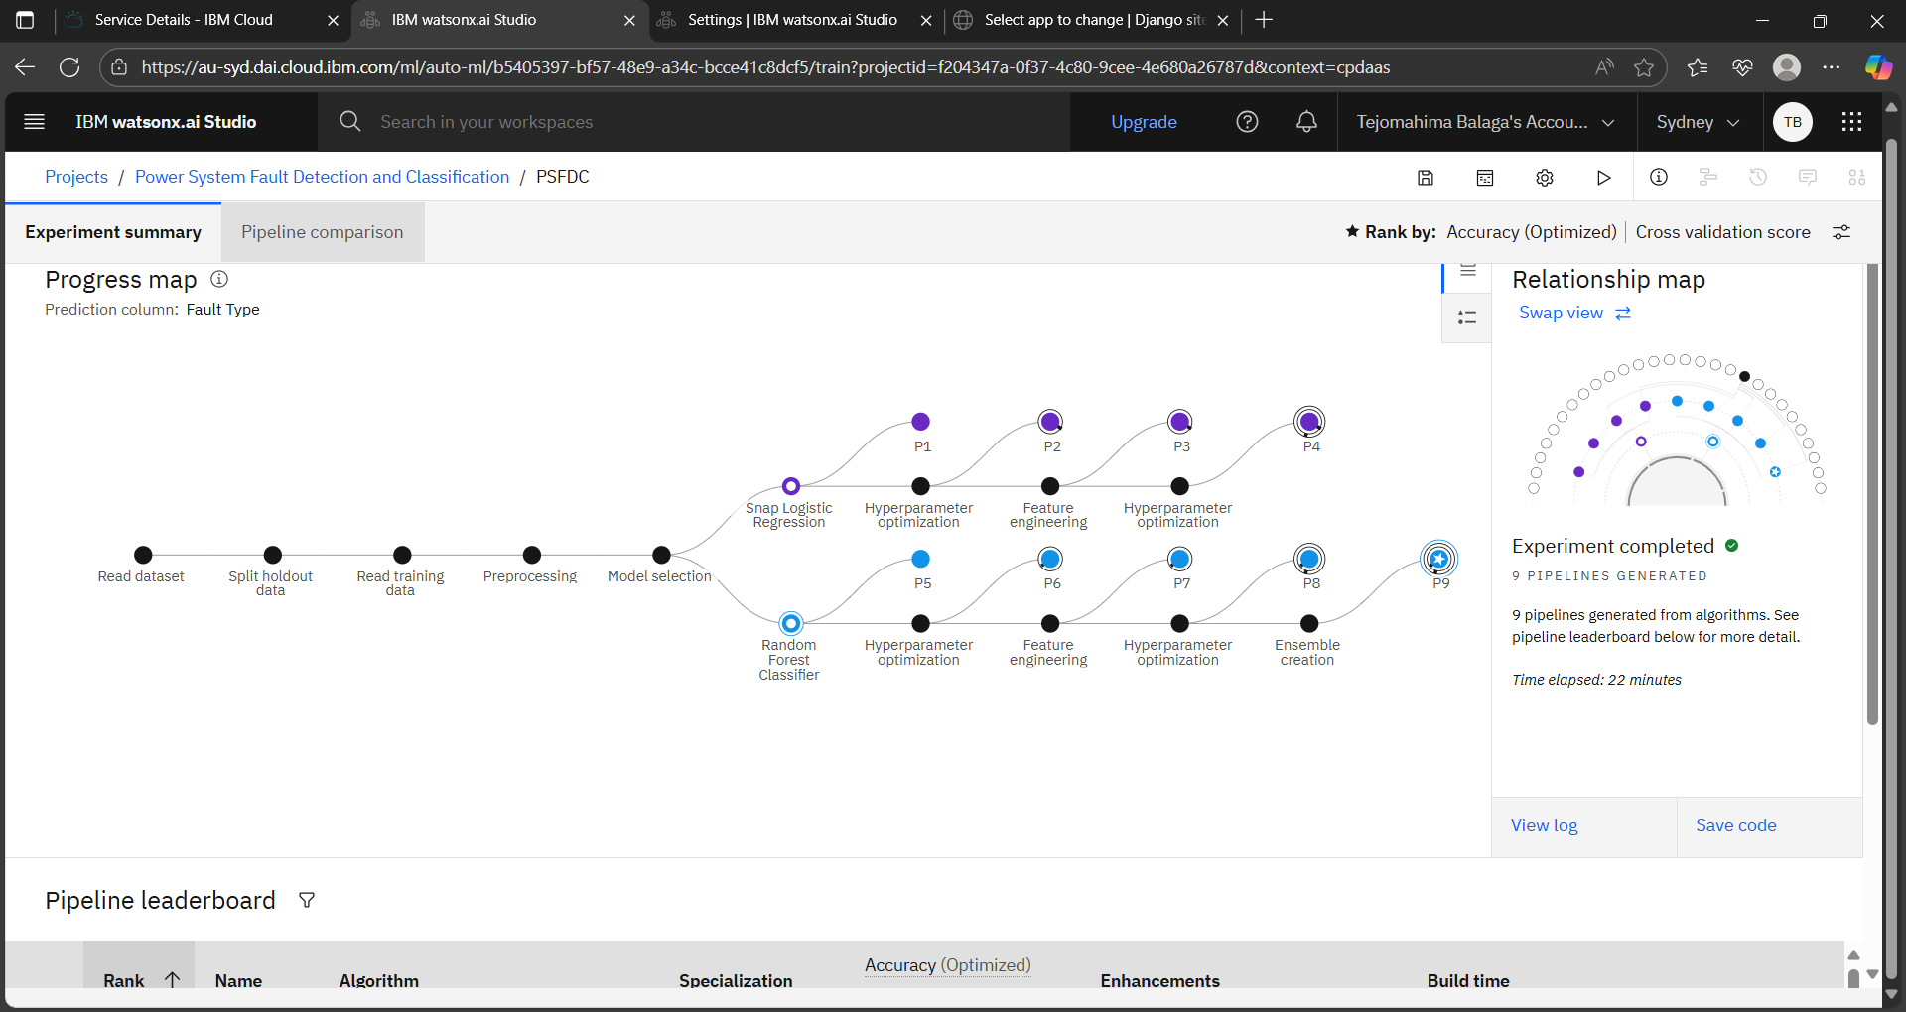
result

Slide 9
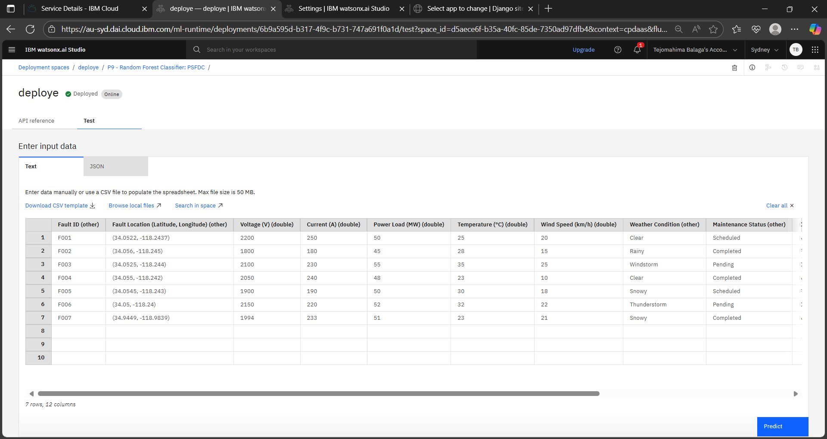
result

Slide 10
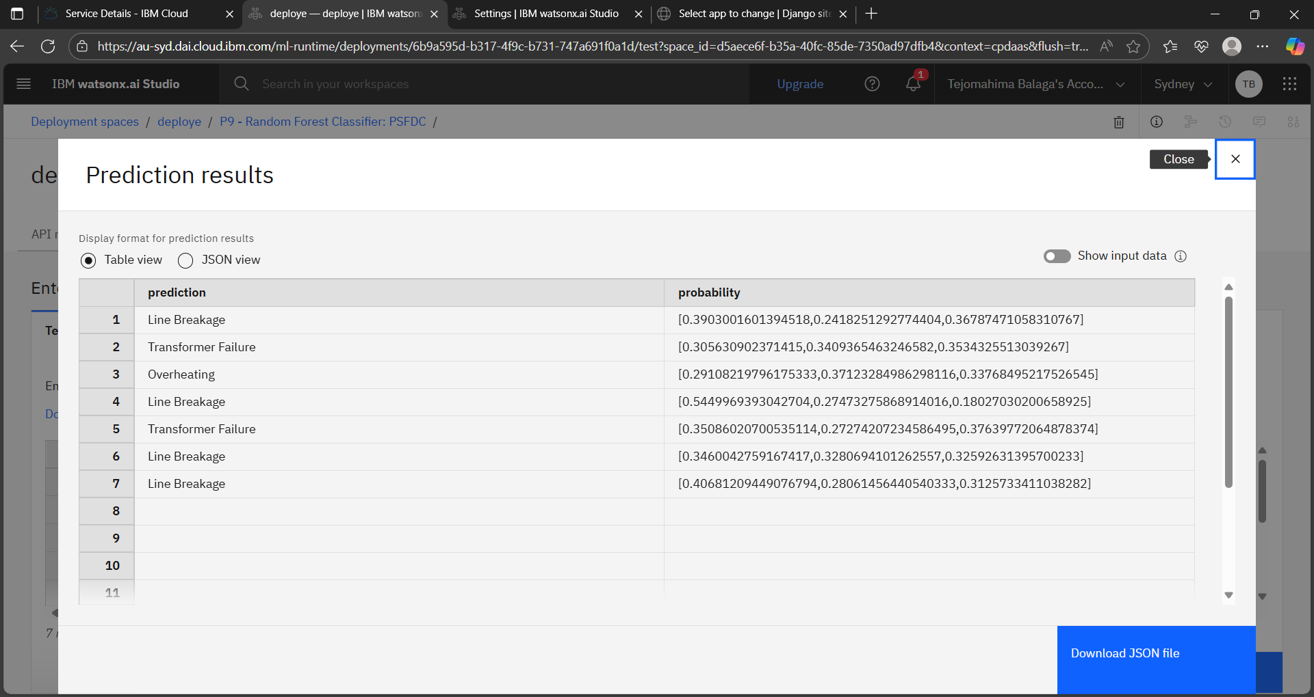
result

Slide 11
Conclusion
The proposed machine learning-based system effectively detects and classifies various types of faults in a power distribution network using voltage and current phasor data. By employing algorithms like Random Forest and deploying the model on IBM Cloud Lite, the solution ensures fast, accurate, and scalable fault identification. This enhances the reliability, safety, and efficiency of modern power systems, supporting real-time monitoring and quicker fault recovery. The system can be further expanded to integrate real-time sensor inputs and advanced AI models for smart grid applications.

Slide 12
Future scope
The developed fault detection and classification system has strong potential for further enhancement:
Real-time Monitoring Integration: Connect with live sensor or IoT device data for real-time fault detection and automated response.
Advanced Algorithms: Use deep learning models (e.g., LSTM, CNN) to capture complex patterns and temporal dependencies in phasor data.
Edge Computing: Deploy models on edge devices (e.g., microcontrollers, smart relays) for on-site fault detection in remote areas.
Smart Grid Compatibility: Integrate with smart grid infrastructure to support automated control, fault isolation, and self-healing networks.
Expanded Fault Categories: Extend classification to include more fault types and severity levels for detailed diagnostics.
Visualization Dashboard: Build a web or mobile dashboard to monitor real-time fault predictions, alerts, and system health.

Slide 13
References
Ziya07. Power System Faults Dataset. Kaggle. https://www.kaggle.com/datasets/ziya07/power-systemfaults-dataset
Breiman, L. (2001). Random Forests. Machine Learning, 45(1), 5–32. DOI: 10.1023/A:1010933404324
Vapnik, V. (1998). Statistical Learning Theory. Wiley.
IEEE Power & Energy Society. Understanding Faults in Power Systems. https://ieeexplore.ieee.org/
IBM Cloud Documentation. Getting Started with Watson Machine Learning. https://cloud.ibm.com/docs/watson-machine-learning

Slide 14
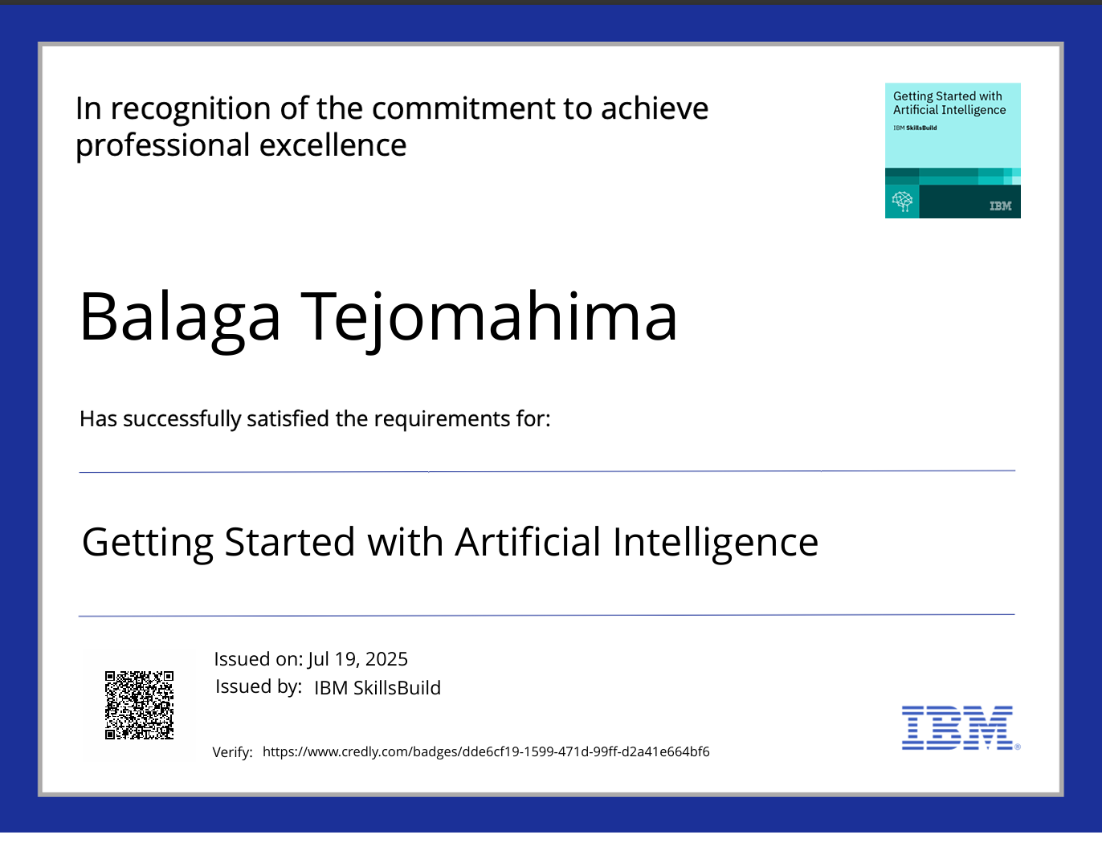
IBM Certifications

Slide 15

IBM Certifications

Slide 16
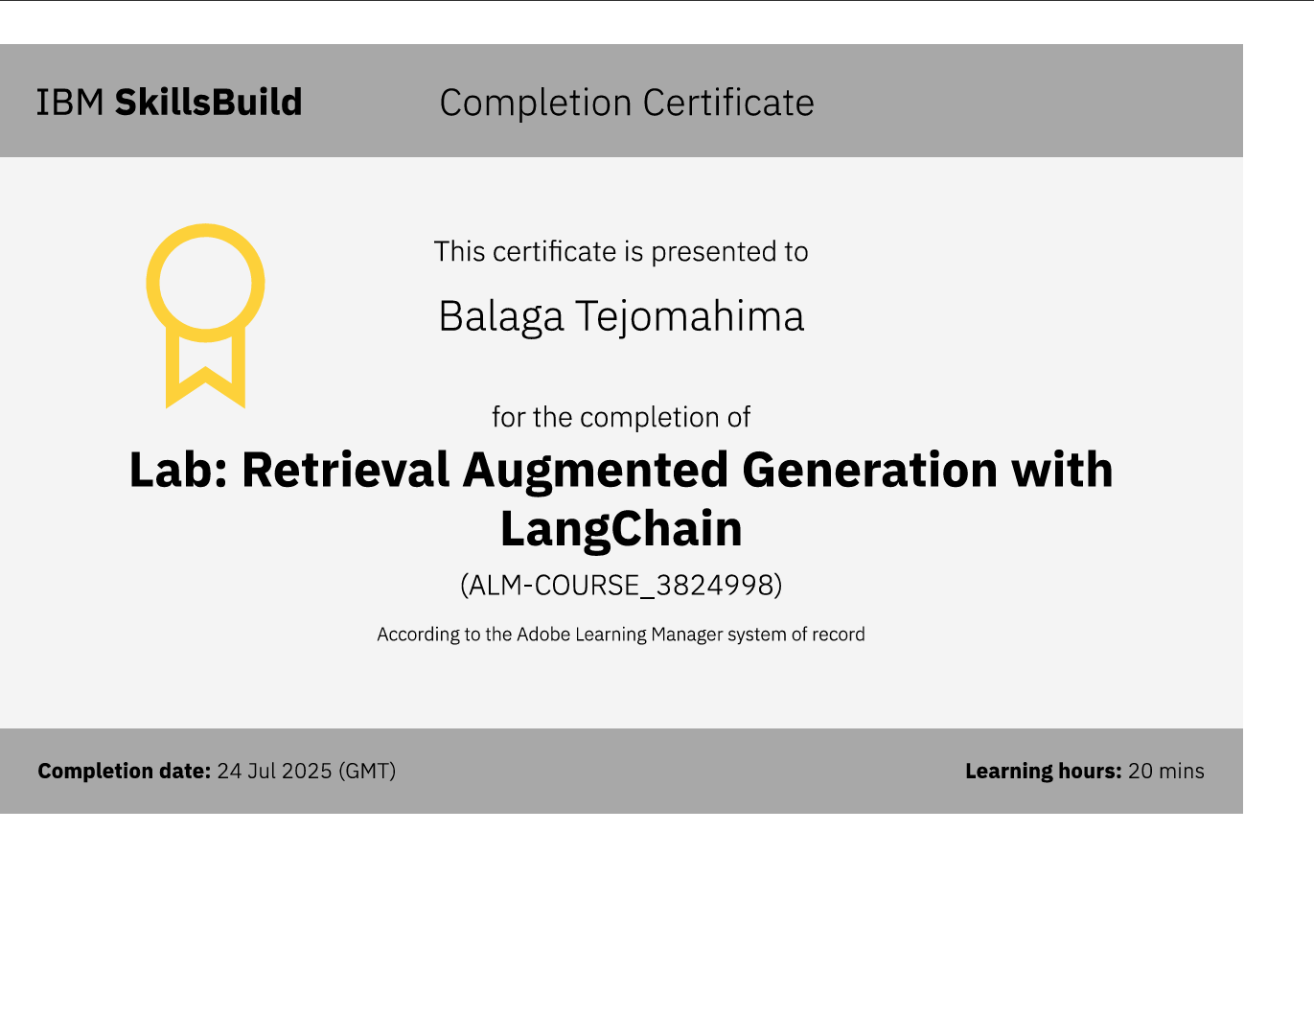
IBM Certifications
Github link:

Slide 17
THANK YOU

